Slide 1




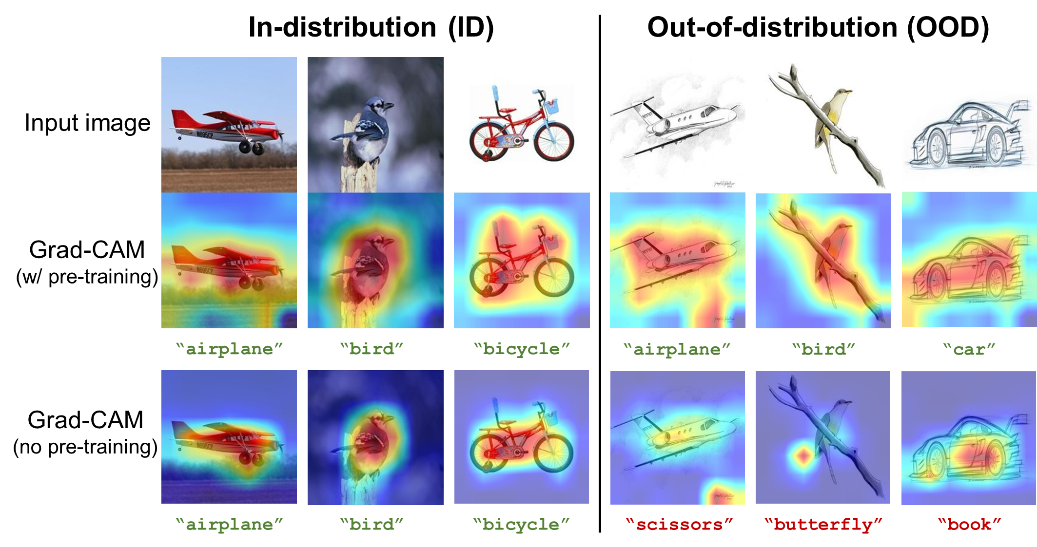
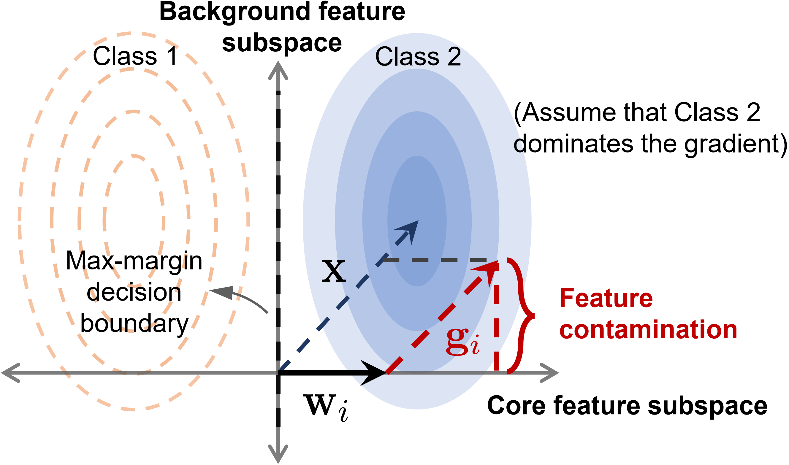
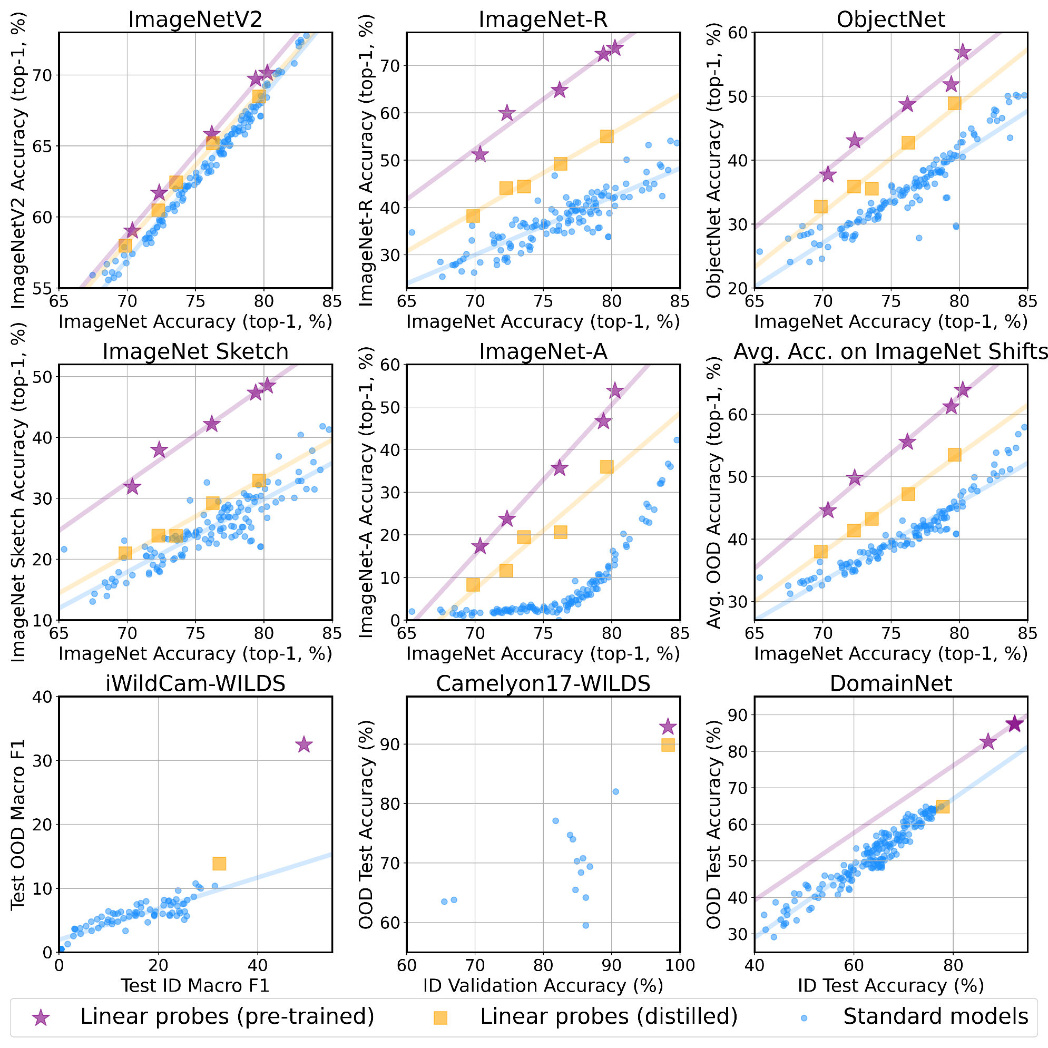
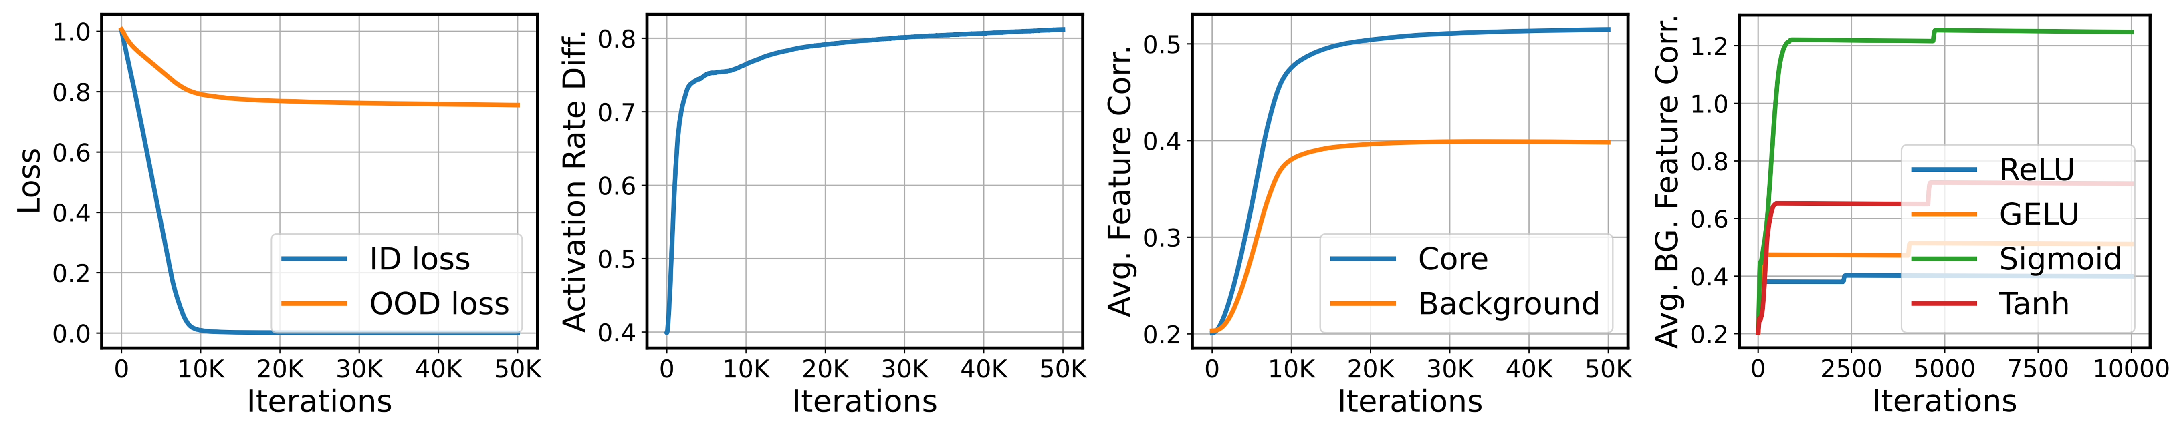
NNs are task-driven feature learners. But are all features learned by NNs task-relevant?
(and how does that relate to generalization?)
Paper
Feature contamination: Neural networks learn uncorrelated features and fail to generalize
Tianren Zhang*^{,1}, Chujie Zhao*^{,1}, Guanyu Chen¹, Yizhou Jiang¹, Feng Chen^{1,2}
Code & poster
¹ Department of Automation, Tsinghua University ² LSBDPA Beijing Key Laboratory
Background
Main findings & takeaways
Recent algorithmic advances in OOD generalization have been limited.
Many algos with theoretical guarantees do not excel in practice.
Simply using pre-trained models often works fine. (But is it still OOD?)
Takeaways
NNs can learn "useless features" that are uncorrelated with the label while learning predictive features ("feature contamination") and, due to this bias, fail to generalize OOD.
Cause: activation asymmetry of neurons for inputs from different classes --- due to non-linear activation & inductive bias of SGD
Orthogonal to spurious correlations
Not all features learned by NNs are task-relevant; task-relevant and task-irrelevant features can be non-linearly coupled in the NN’s activation space.
Nonlinearity in NNs elicits new OOD generalization challenges beyond spurious correlations.
OOD generalization algos should explicitly consider inductive biases.
Why?
Our conjecture: existing analysis
only focuses on spurious correlations (models may learn features that are correlated with the label, yet non-causal)
does not capture the inductive biases of (non-linear) NNs, e.g., feature learning
Empirical study
Theoretical results
A main stream of OOD generalization algos focuses on representation learning (e.g., domain invariant / domain specific / diverse).
We ask: is a "good enough" repr. learning objective sufficient for OOD generalization?
An "idealized" setting: train a student NN to explicitly fit the repr. from a teacher NN that can generalize OOD (repr. distillation).
Model: two-layer ReLU NN trained by SGD
Task: binary classification
Data:
is an orthogonal matrix
[core features, background features]
Correlated with label;
same in ID/OOD data
Uncorrelated with label;
different in ID/OOD data
(+ linear probe
evaluation)
Key insight:
Activation asymmetry: Neuron activation magnitudes are different for different classes; one class dominates the gradient
Feature contamination:
Expected gradient
Results
Scalar
Contains both core & bg. features
Student NN still cannot generalize OOD well (though being better than the no teacher setting)!
Cannot be explained by spurious correlations / other existing explanations.
Only considering the objective is not enough --- need to take into account the inductive biases in NN optimization!
Empirical results show that feature contamination also occurs for other data models / activation functions / optimizers / NN architectures.
Check our paper for more empirical evidence of feature contamination in deep NNs!

Slide 2




NNs are task-driven feature learners. But are all features learned by NNs task-relevant?
(and how does that relate to generalization?)
Paper
Feature contamination: Neural networks learn uncorrelated features and fail to generalize
Tianren Zhang*^{,1}, Chujie Zhao*^{,1}, Guanyu Chen¹, Yizhou Jiang¹, Feng Chen^{1,2}
Code & poster
¹ Department of Automation, Tsinghua University ² LSBDPA Beijing Key Laboratory
Background
Recent algorithmic advances in OOD generalization have been limited.
Many algos with theoretical guarantees do not excel in practice.
Simply using pre-trained models often works fine. (But is it still OOD?)
Main findings and takeaways
Takeaways
NNs can learn "useless features" that are uncorrelated with the label while learning predictive features ("feature contamination") and, due to this bias, fail to generalize OOD.
Cause: activation asymmetry of neurons for inputs from different classes --- due to non-linear activation & inductive bias of SGD
Orthogonal to spurious correlations
Not all features learned by NNs are task-relevant; task-relevant and task-irrelevant features can be non-linearly coupled in the NN’s activation space.
Nonlinearity in NNs elicits new OOD generalization challenges beyond spurious correlations.
OOD generalization algos should explicitly consider inductive biases.
Why?
Our conjecture: existing analysis
only focuses on spurious correlations (models may learn features that are correlated with the label, yet non-causal)
does not capture the inductive biases of (non-linear) NNs, e.g., feature learning
Empirical study
Theoretical results
A main stream of OOD generalization algos focuses on representation learning (e.g., domain invariant / domain specific / diverse).
We ask: is a "good enough" repr. learning objective sufficient for OOD generalization?
An "idealized" setting: train a student NN to explicitly fit the repr. from a teacher NN that can generalize OOD (repr. distillation).
Model: two-layer ReLU NN trained by SGD
Task: binary classification
Data:
is an orthogonal matrix
[core features, background features]
Correlated with label;
same in ID/OOD data
Uncorrelated with label;
different in ID/OOD data
(+ linear probe
evaluation)
Key insight:
Activation asymmetry: Neuron activation magnitudes are different for different classes; one class dominates the gradient
Feature contamination:
Results
Expected gradient
Scalar
Contains both core & bg. features
Student NN still cannot generalize OOD well (though being better than the no teacher setting)!
Cannot be explained by spurious correlations / other existing explanations.
Only considering the objective is not enough --- need to take into account the inductive biases in NN optimization!
Empirical results show that feature contamination also occurs for other data models / activation functions / optimizers / NN architectures.
Check our paper for more empirical evidence of feature contamination in deep NNs!

